Slide 1





The Phoenix/New Freedom 100
A Proven Effective, Evidence-Based
Gang Intervention

Slide 2
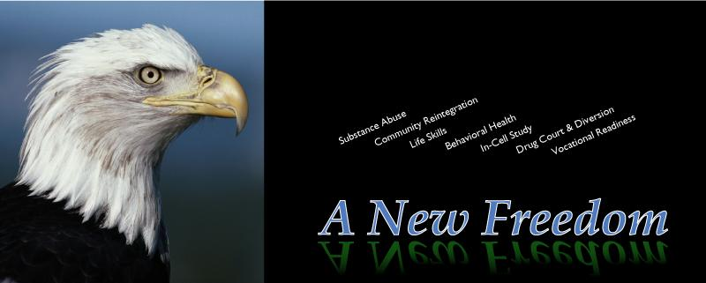
About Phoenix/New Freedom Programs

Slide 3
Phoenix/New Freedom Programs
Phoenix/New Freedom evidence-based resources are currently in use in more than 2500 programs in 50 states, including:
every juvenile justice residential facility statewide in New Mexico, Arizona, Montana, Minnesota, Rhode Island, New York, and more
every juvenile justice facility in Georgia both long-term and short-term
every juvenile justice facility and program in Virginia
every juvenile justice program in Massachusetts
all residential facilities of the Ohio Department of Youth Services
all residential juvenile facilities in North Carolina and North Dakota
every juvenile justice commission facility and program statewide, and every county juvenile detention facility in New Jersey
every juvenile male correctional facility in Texas, Alaska, Wyoming, and Wisconsin

Slide 4


Phoenix/New Freedom Programs
Phoenix/New Freedom resources– especially the Phoenix/New Freedom 100-- have been designated officially by the US Department of Justice as an evidence-based program through the National Gang Center, Bureau of Justice Assistance, Office of Juvenile Justice and Delinquency Prevention.

Slide 5

Riker’s Island uses our materials in two programs: A Road Not Taken (substance abuse) and Beyond The Bridge (mental health).
In the year following introduction of A Road Not Taken, drug court judges began to note that inmates who completed the program were not being re-arrested as frequently as those who did not receive the programming. As a result, the program was officially partnered with the drug courts, and judges began sentencing offenders directly into the program.

Slide 6
In October of 2012, research data from A Road Not Taken was selected to be presented at the American Public Health Association 140th Annual Meeting and Expo in San Francisco. Among the findings:
41.67% reduction in multiple re-arrests
23% reduction - to 32% - of recidivism for those experiencing a longer length of stay (more than 41 days) in the program.

Slide 7

What kinds of programs work?
Notes:
Name some types of programs:
Boot camps
Oriented towards instilling discipline
Deterrence
Fear of consequences
Surveillance
Parole programs, etc.
Restorative
Restitution, victim-offender mediation
Skill Building
cognitive-behavioral techniques, skill-building
Counseling
Individual, group, family
Multiple Services
Case management intensive parole or parole supervision

Slide 8

Dr. Mark W. Lipsey (the leading researcher on program effectiveness in the country) with Dr. James C. Howell (of the National Gang Center) recently completed a study designed to measure the effectiveness of juvenile programs.

Slide 9
What kinds of programs work?
They found that juvenile programs in general can be put into two basic categories:
Control
Therapeutic
Boot camps and other discipline programs
Deterrence (like Scared Straight)
Surveillance
Restorative
Skill Building
Counseling
Multiple Services
Notes:
Boot camps
Oriented towards instilling discipline
Deterrence
Fear of consequences
Surveillance
Parole programs, etc.
Restorative
Restitution, victim-offender mediation
Skill Building
cognitive-behavioral techniques, skill-building
Counseling
Individual, group, family
Multiple Services
Case management intensive parole or parole supervision

Slide 10
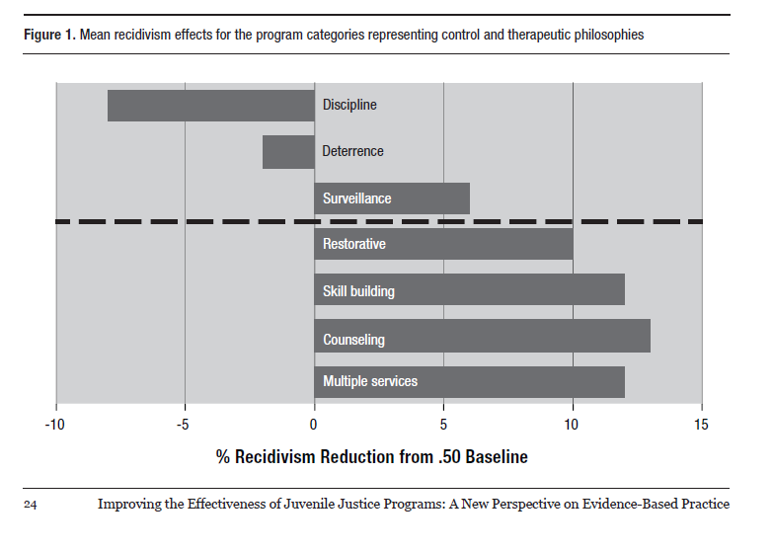
The results were that some programs from the Control category actually increased recidivism. Programs from the Therapeutic category reduced recidivism.

Slide 11
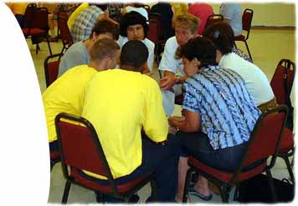



What kinds of programs work?
The report concluded:
“To optimize the effects on recidivism and other outcomes, programs from the therapeutic categories should be favored and those from the control categories should be avoided as much as possible.”
Notes:
So therapy rather than control have more of an impact on recidivism.
There are a lot of programs in the therapeutic categories– so the next step was to determine what makes the successful ones work.

Slide 12
What kinds of programs work?
Dr. Lipsey looked at successful vs. non-successful programs and research. Success was determined by recidivism.
He found that some famous curriculums and programs were successful, but many more did not have the fame but were equally successful.
The key difference was that successful programming shared certain common features.
Notes:
So what are some of these common features?

Slide 13
What kinds of programs work?
CBT-based (addresses thinking, dealing with feelings, and behavior/skills)
Group Counseling of sufficient dosage over an extended period of time. Participants need time to think and absorb the material.
Risk Factors: program needs to focus on the predictive risk factors for re-offending.

Slide 14
What kinds of gang programs work?
Behavior rehearsal (role modeling, role play, social learning model).
Relapse prevention - self-efficacy
Fidelity Monitoring

Slide 15
What kinds of gang programs work?
Two other areas that look promising but data is still being gathered:
Motivational Interviewing
The Stages of Change
Notes:
So if a program you are considering, even if you made it yourself, has these features, you can have a certain amount of confidence that it will work.

Slide 16
The Phoenix/New Freedom 100
A Proven Effective, Evidence-Based
Gang Intervention

Slide 17
The Phoenix/New Freedom 100
100 one-hour lessons organized into five 20-lesson books to be done sequentially
cognitive-behavioral treatment (CBT) model, tailored for this population
incorporation of Motivational Interviewing tools directly into the curriculum

Slide 18
The Phoenix/New Freedom 100
linked to the Stages of Change Model
tailored for this population and age; high interest-easy reading
addresses specific internal and external key risk factors for juvenile offending and re-offending

Slide 19
Program Goals
Increased self-efficacy against the highest and most common risk factors for delinquency and gang involvement.
  Can identify a high risk, danger, or problem situation.
  Knows effective ways to deal with this situation.
  Has confidence that they will work.
  Has practiced addressing these issues over and over again.
Notes:
Let’s talk about each of these

Slide 20
Program Goals
To address their risk factors, participants will:
Master a three-step Problem Solving Process.
Practice, practice, practice, using the most common risk factors (people, places, things, and situations that increase their risk or put them in danger).
Notes:
Let’s talk about each of these

Slide 21
Program Goals
Increased interaction with available protective factors
Identifies safe people (family, pro-social friends, neighbors, teachers, mentors), places, and activities (positive and rewarding experiences)

Slide 22
Program Goals
Reduction in Risk
Improved school performance
Increased community/pro-social involvement
Positive peer relationships
Prevention or reduction of
  --violence
  --gang involvement
  --bullying
  --other criminal behavior
  --substance use/abuse

Slide 23
Program Goals
Participants demonstrate positive behavior through:
Solving problems (especially in relation to high
risk factors).
Avoiding problems, using escape, resistance, and refusal skills.
Asking for help from safe and supportive people.
Managing feelings effectively.
Controlling impulses.

Slide 24
Program Goals
Clear movement on measures of change:
Book 1: Pre-Contemplation to Contemplation
Book 2: Contemplation
Book 3: Contemplation to Preparation/ Determination
Book 4: Preparation/ Determination to Action
Book 5: Preparation/ Determination to Action
Each book features activities and programming appropriate for the identified Stage of Change.
Notes:
You may notice Books 4 and 5 share Preparation/ Determination to Action– this is because the Action stage is very hard to achieve even in a program as long as this. But if they leave the program in the Preparation/ Determination stage, we feel we have accomplished our goal.

Slide 25
Program Goals
Increased awareness of the importance of making a change, their readiness to make a change, and their confidence in their ability to make a change
This curriculum includes MI tools as part of the individual lessons.
The objective is to keep the focus on the idea of change.
The purpose of intervention programming is for the participants to make changes in their thinking – and their behavior! The MI tools keep this focus.
Notes:
.

Slide 26
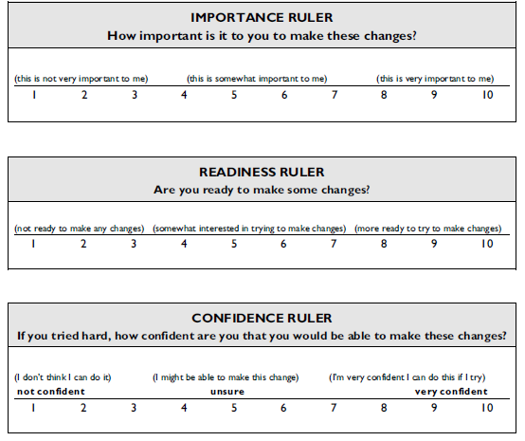
Program Goals
Frequent MI
assessments allow
participants and staff
to discuss the importance
of making positive
changes, their confidence
they can make pro-social
changes, and their
readiness to keep this
process moving forward.
These rulers appear at the
end of every fifth lesson.
Notes:
.

Slide 27
Program Goals
Their self-report on these instruments can be compared to the leader’s evaluation – and this can provide the opportunity for change, too!
The tools allow you to track progress and address those who are not making sufficient progress.
Notes:
.

Slide 28
Evaluation
The Phoenix/New Freedom 100 is designed to assist and enable a wide range of assessment and evaluation.
Tools have been provided for formal individual and group assessments (stages of change) at the end of every 20 program hours.
Competency Checklists and various MI tools track individual progression throughout the curriculum.
Pre and Post tests may be administered using your approved , state-mandated assessment tool.
Notes:
Any questions?

Slide 29
Program Features
100 hours of programming, divided into 5 Books of 20 hours each
cognitive-behavioral treatment (CBT) model, tailored for this population
incorporation of Motivational Interviewing (MI) tools
linked to the Transtheoretical Stages of Change Model (Prochaska and DiClemente)
tailored for this population and age; high interest-easy reading
addresses specific internal and external key risk factors for juvenile offending and re-offending
Continued on next slide

Slide 30
Program Features
closed group format, allowing the stages of group growth to support the intervention
outcome driven, with step-by-step monitoring of personal change
replicable format, with significant staff support elements
Logic model

Slide 31
What can you expect to see in your facility?
After 6 months:
Evident change
Reduction in number of behavioral problems
Reduction in number of disciplinary problems
Increase in buy-in as the group becomes part of daily operations.

